Slide 2

Notes:
Oceanic Flight 815

Slide 4
Regulatory banking reporting at Banco de España
Some functions require the collection of data from credit institutions:
  Promotion of the stability of the financial system
  Preparation and publication of statistics
  Gathering data for the European Central Bank
Process
  Regulation laws are published : definition of concepts required and its schedule
  Data is received and debugged through a validation process
  Clean data is available for analysts
Some numbers
  More than 150 financial statements in use (more than 300 in total)
  About 40.000 different financial concepts defined
  More than 28.000 quality checks defined
  More than 100.000 statements processed per year

Slide 5
Implementation of a new regulation law (classic approach)
Regulator
C
Business
user
IT analyst
System
requirements
IT developer
Code
Regulation law
Commercial bank
C
Business
user
IT analyst
System
requirements
IT developer
Code

Slide 6
Data filing and validation process (classic approach)
Regulator
Analysis
Errors detected
Notification
Validation OK
Commercial bank
Data extraction
Data extraction
Analysis
and corrections
Notes:
Commercial bank’s systems are debugged during the first reporting months !!!

Slide 7
Complexity of the whole process
400 credit institutions
Sender
Sender
Sender
Sender
Sender
Sender
Regulator
Sender
Sender
Sender
Sender
Sender
Sender

Slide 8
Implementation of a new regulation law (XBRL approach)
Regulator
Business
user
IT analyst
Commercial banks
Regulation
Law
XBRL
Taxonomy
Business
user

Slide 9
Data filing and validation process (XBRL approach)
Regulator
Analysis
Validation OK
Commercial banks
Data extraction
& local validation
Analysis
And corrections

Slide 10
XBRL Projects
FINREP 2012
COREP 2012
Taxonomy development
Nº Participants: > 300
Nº Filings / year: > 1000
ECB BSI and MRI
statistics
Nº Participants: > 300
Nº Concepts (EU): ~ 1.700
Nº Dimensions (EU): 12
Mutual guarantee
Exchange offices
Nº Participants: > 300
Nº Filings/year: ~1000
Nº Concepts (EU): ~ 950
Nº Dimensions (EU): 22
Add. Concepts (ES): ~ 553
Add. Dimensions (ES): 8
Sectorial
Statements
(FINREP)
Nº Participants: > 300
Nº Filings/year: > 7000
Nº Concepts: > 650
Solvency
Information
(COREP)
Nº Participants: > 50
Nº Filings/year: > 200
Nº Concepts: > 950
Public Statements
(IFRS)
Appraisal
Companies
2004
2005
2006
2007
2008
2009
2010
2011
Notes:
BSI Statistics (balance sheet of the monetary financial institutions sector statistics)
MIR Statistics (monetary financial institutions interest rate statistics)

Slide 11
XBRL Projects
FINREP 2012
COREP 2012
Taxonomy development
Application / infrastructure
Nº Participants: > 300
Nº Filings / year: > 1000
Analysis DB
evolution
ECB BSI and MRI
statistics
Nº Participants: > 300
Nº Concepts (EU): ~ 1.700
Nº Dimensions (EU): 12
Database
migration
Mutual guarantee
Exchange offices
Nº Participants: > 300
Nº Filings/year: ~1000
Nº Concepts (EU): ~ 950
Nº Dimensions (EU): 22
Add. Concepts (ES): ~ 553
Add. Dimensions (ES): 8
Multi-instance
validation
Sectorial
Statements
(FINREP)
Nº Participants: > 300
Nº Filings/year: > 7000
Nº Concepts: > 650
Solvency
Information
(COREP)
Taxonomy
viewer
XBRL Formula
integration
Nº Participants: > 50
Nº Filings/year: > 200
Nº Concepts: > 950
SIIF Dimensions
Evolution
Public Statements
(IFRS)
SIIF System
Basic XBRL
Infrastructure
Appraisal
Companies
XBRL
Prototype
2004
2005
2006
2007
2008
2009
2010
2011

Slide 12

Implementation
Banco de España
Financial Institutions
XBRL filings
SIIF
XBRL Formula
Validation
Process
Submissions
Management
Other applications
Validation results
XBRL
Taxonomy
Main
Data repository
Notes:
Formula Validation

Slide 13
Implementation
Banco de España
Financial Institutions
Helper services
Fulfilment state querying
Pre-validation
XBRL viewer
XBRL on-line forms
Taxonomy browsing
XBRL
Metadata
Main
Data repository

Slide 14
XBRL Projects
FINREP 2012
COREP 2013
Nº Participants: > 300
Nº Filings / year: > 1000
ECB BSI and MRI
statistics
Nº Participants: > 300
Nº Concepts (EU): ~ 1.700
Nº Dimensions (EU): 12
Mutual guarantee
Exchange offices
Nº Participants: > 300
Nº Filings/year: ~1000
Nº Concepts (EU): ~ 950
Nº Dimensions (EU): 22
Add. Concepts (ES): ~ 553
Add. Dimensions (ES): 8
Sectorial
Statements
(FINREP)
Nº Participants: > 300
Nº Filings/year: > 7000
Nº Concepts: > 650
Solvency
Information
(COREP)
25.000 new validations rules
(multiple instance validation)
Nº Participants: > 50
Nº Filings/year: > 200
Nº Concepts: > 950
Public Statements
(IFRS)
22.000 instance documents received
10.000 validation rules defined
1.200 XBRL assertions needed
60.000 errors detected
Appraisal
Companies
2004
2005
2006
2007
2008
2009
2010
2011
Notes:
BSI Statistics (balance sheet of the monetary financial institutions sector statistics)
MIR Statistics (monetary financial institutions interest rate statistics)

Slide 15
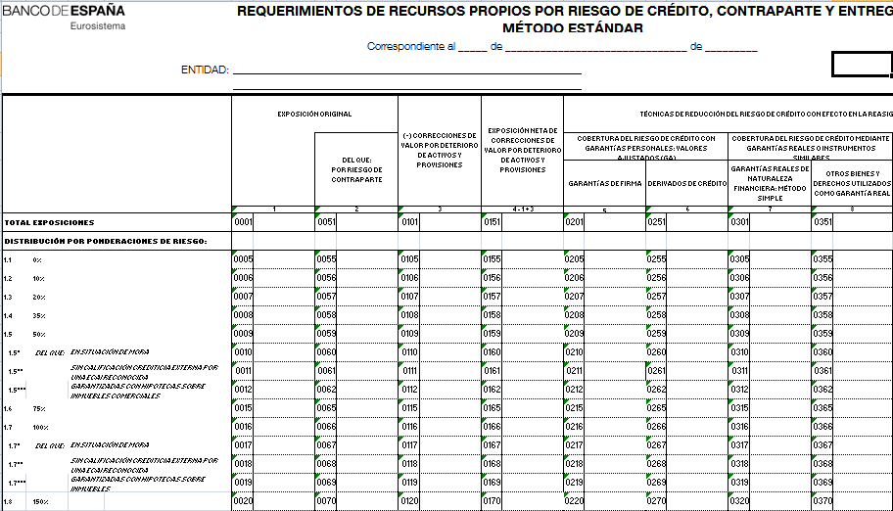
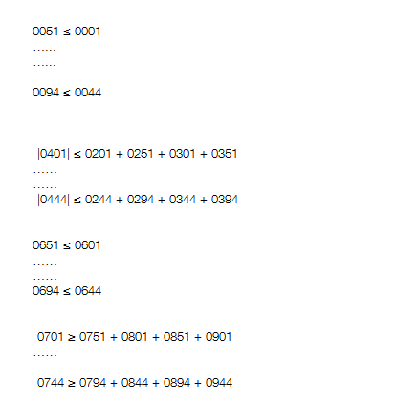
Former approach

Slide 16
Conclusions
Better maintainability:
  Striking reduction in the number of rules to maintain (reduced to a 10%)
Validation rules expressed in business terms
Reusability between different actors
  Regulators and credit institutions
  Different countries:
    European rules
    Domestic ones
Data available sooner and improved quality
  Standard and formal language to express formulae
  Can be validated at the source of information
Poor understanding of XBRL by credit institutions

